Slide 1
Viola-Jones Algorithm

Slide 2
The Viola-Jones (V-J) object detection framework is the first object detection framework to provide competitive object rates in real-time proposed. It can be trained to detect a variety of object classes. In OpenCV, it’s implemented as cvHaarDetectObjects() and the new method for multithread is cascadeClassifier()
Reference: http://en.wikipedia.org/wiki/Viola%E2%80%93Jones_object_detection_framework

Slide 3
Key ideas of Viola-Jones:
Integral images for fast feature evaluation
Boosting for feature selection
Attentional cascade for fast rejection of non-object windows
Notes:
Integral image: tam dich -> anh lien doi
Cascade: mo hinh thac

Slide 4
Viola-Jones Technique:
Feature extraction and feature evaluation
Classifier training a feature selection using a method called AdaBoost.
A degenerate decision tree of classifiers is formed.

Slide 5
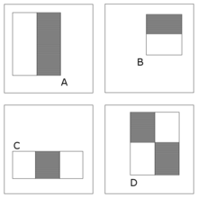
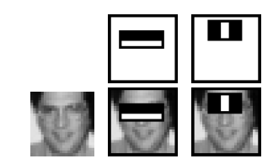
Feature extraction and feature evaluation:
Feature extraction:
Rectangle feature with four basic types. Value = sum( pixels in black area) – sum(pixels in white area)
Each feature is related to a special location in the sub-window
Each feature may have any size
Four basic types

Slide 6
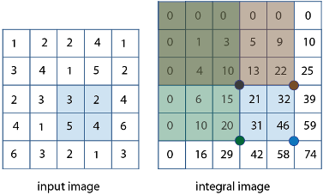
Feature extraction and feature evaluation:
Feature evaluation: using Integral Image for rapid computation of rectangular features.

Slide 7
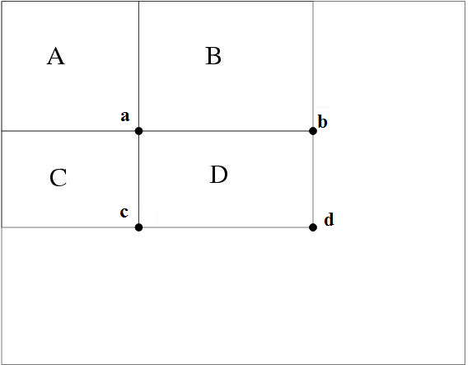
For example the integral sum inside rectangle D can be computed as: ii(d) + ii(a) – ii(b) – ii(c)
ii(a) = A
ii(b) = A+B
ii(c) = A+C
ii(d) = A+B+C+D
D = ii(d)+ii(a)-ii(b)-ii(c)

Slide 8
Feature selection
Using AdaBoost stands for “Adaptive” boost
Constructs a “strong” classifier as a linear combination of weighted simple “weak” classifiers
Features as weak classifiers: each single feature may be regarded as a simple weak classifier.
An iterative algorithm: AdaBoost performs a series of trials, each time selecting a new weak classifier.
Weights are being applied over the set of the example images: during each iteration, each example/image receives a weight determining it importance.

Slide 9
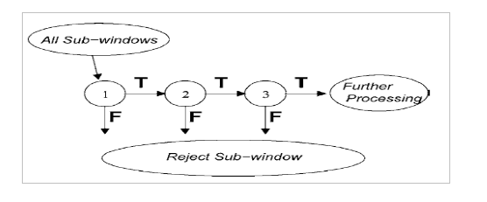
Decision tree: Attentional Cascade
The reason the technique is fast.
Quick rejection of sub windows.
Attentional Cascade

Slide 10
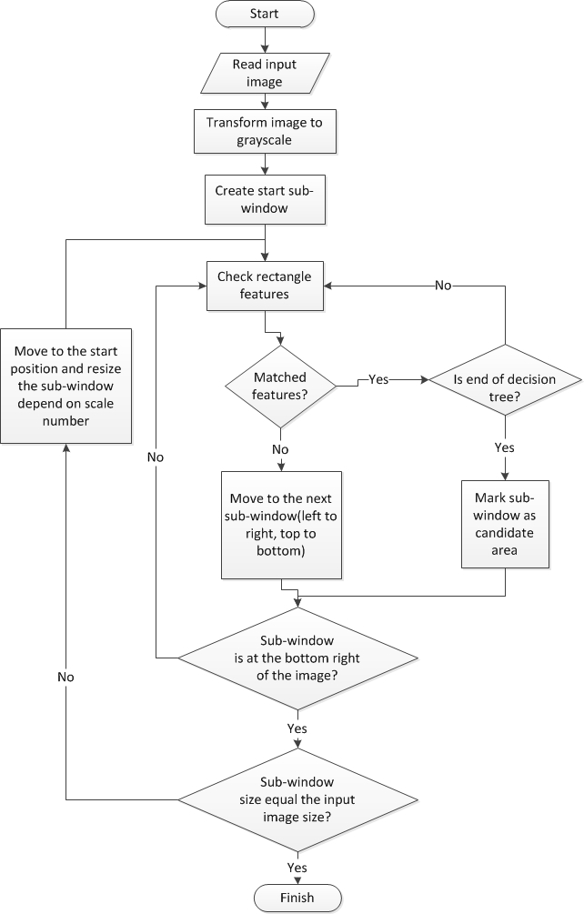
Important parameters:
Min – max size of the sub-window
Scale size (percent)

Slide 11
Train data to use Viola-Jones algorithm
To apply the algorithm in project, we device traffic sign into 2 main class: one for triangle traffic sign (warning traffic sign), one for circle traffic sign (prohibitory, mandatory traffic sign).
The image use to train each class contain 2 types:
Positive image: contain only traffic sign image clipped.
Negative image: contain what every image not have traffic sign, such as the image of street, market, tree…

Slide 12
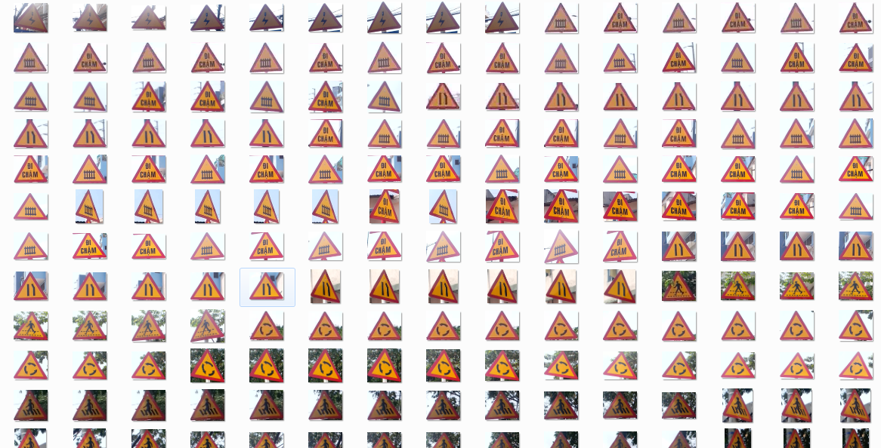
Triangle Traffic Sign Train Sample Image

Slide 13
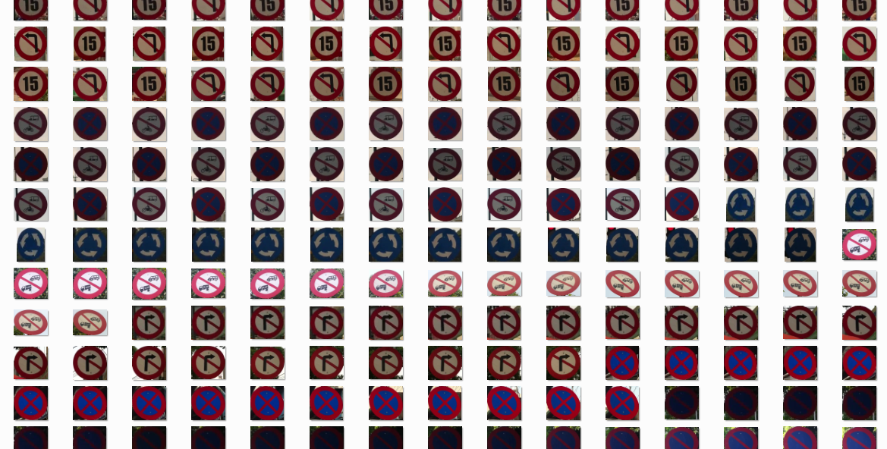
Circle Traffic Sign Train Sample Image

Slide 14
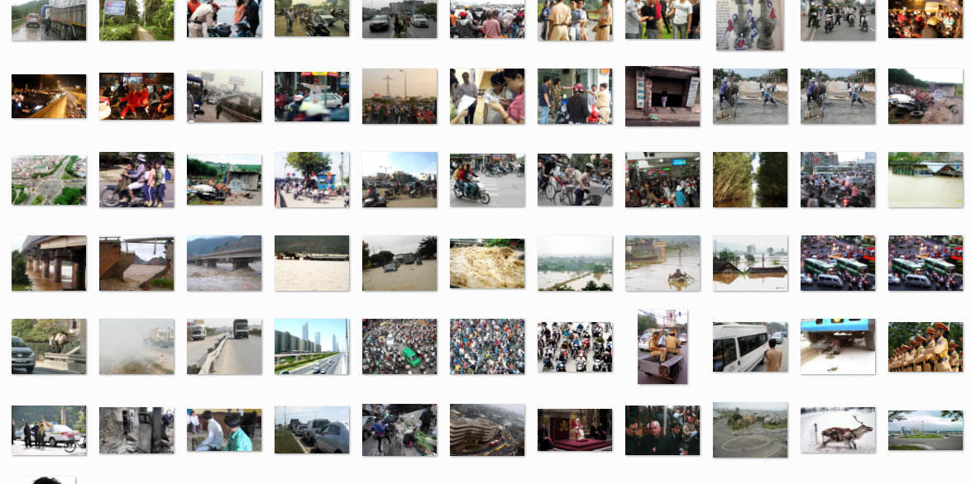
Negative Train Sample Image

Slide 15
Train Classifier
We trained the image many time and get the best detection rate with about 700 positive images and 1500 negative images to each class (see the performance measures about the detection accuracy chart). The time need to train each class is about 3 days with Core i3 M350 2.27 GHz, 2GB Ram available. The result of each train is a XML cascade file contain features to detect traffic sign.

Slide 16
Performance:
With image resolution: 800x460px
Web module: Ubuntu 13.10 with core i3 M350 2.27GHz, 3GB Ram
Best traffic sign detected result: 60/84 traffic sign (02 classes). Percent: 71.4%
Worst traffic sign detected result: 56/84 traffic sign (02 classes). Percent 66.7%
Detection rate of class 1st base on different train image data:
Traffic Sign Detection Accuracy
Mobile module: Android 4.0 with 2 cores 1GHz, 512MB Ram
Average time to detect traffic sign: 0.357s (2.8 FPS)

